Slide 1
Reports on alleged attacks on healthcare in Idlib, Syria Press conference of the Permanent Representative of the Russian Federation to the United Nations MR.VASSILY NEBENZIA
Permanent Mission
of the Russian Federation
to the UN
Notes:
Work started in Syria

Slide 3
Kafer Zaita (Kafr Zita)
Public Health Facility
(factual coordinates:
35°24'12.05"N 36°34'27.75"E)

Slide 4
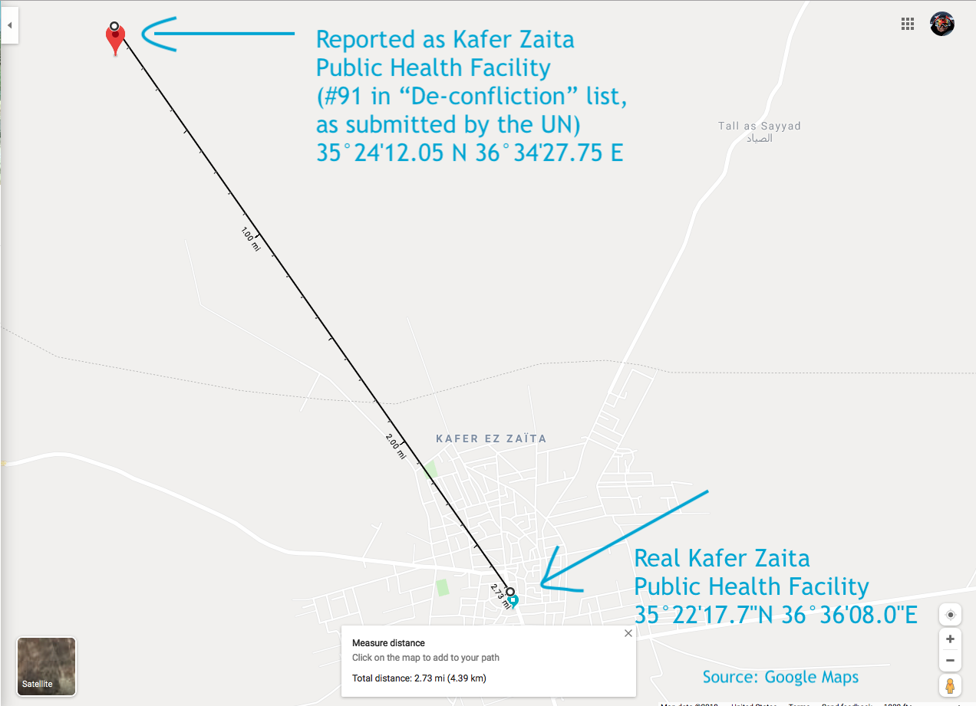

Slide 5
Actual facility found at reported coordinates
Power lines
Entrance
35°24'12.1"N 36°34'27.8"E, as per the deconfliction list (No.91)

Slide 6
Ma’arat Al-Nu’man Central Hospital
(No.156 in the deconfliction list)
Factual coordinates: 35°39'34.6"N 36°41'15.6"E
Reported coordinates: 35°37'07.7"N 36°46'56.4"E

Slide 7
10KM away
Factual coordinates of
Ma’arat Al-Nu’man Central Hospital
(35°39'34.6"N 36°41'15.6"E)
Jarjanaz
Reported coordinates
(No.156 in the DC list)
(35°37'07.7"N 36°46'56.4"E)

Slide 8
Reported Facility
Function to be confirmed, may be a former police outpost

Slide 9
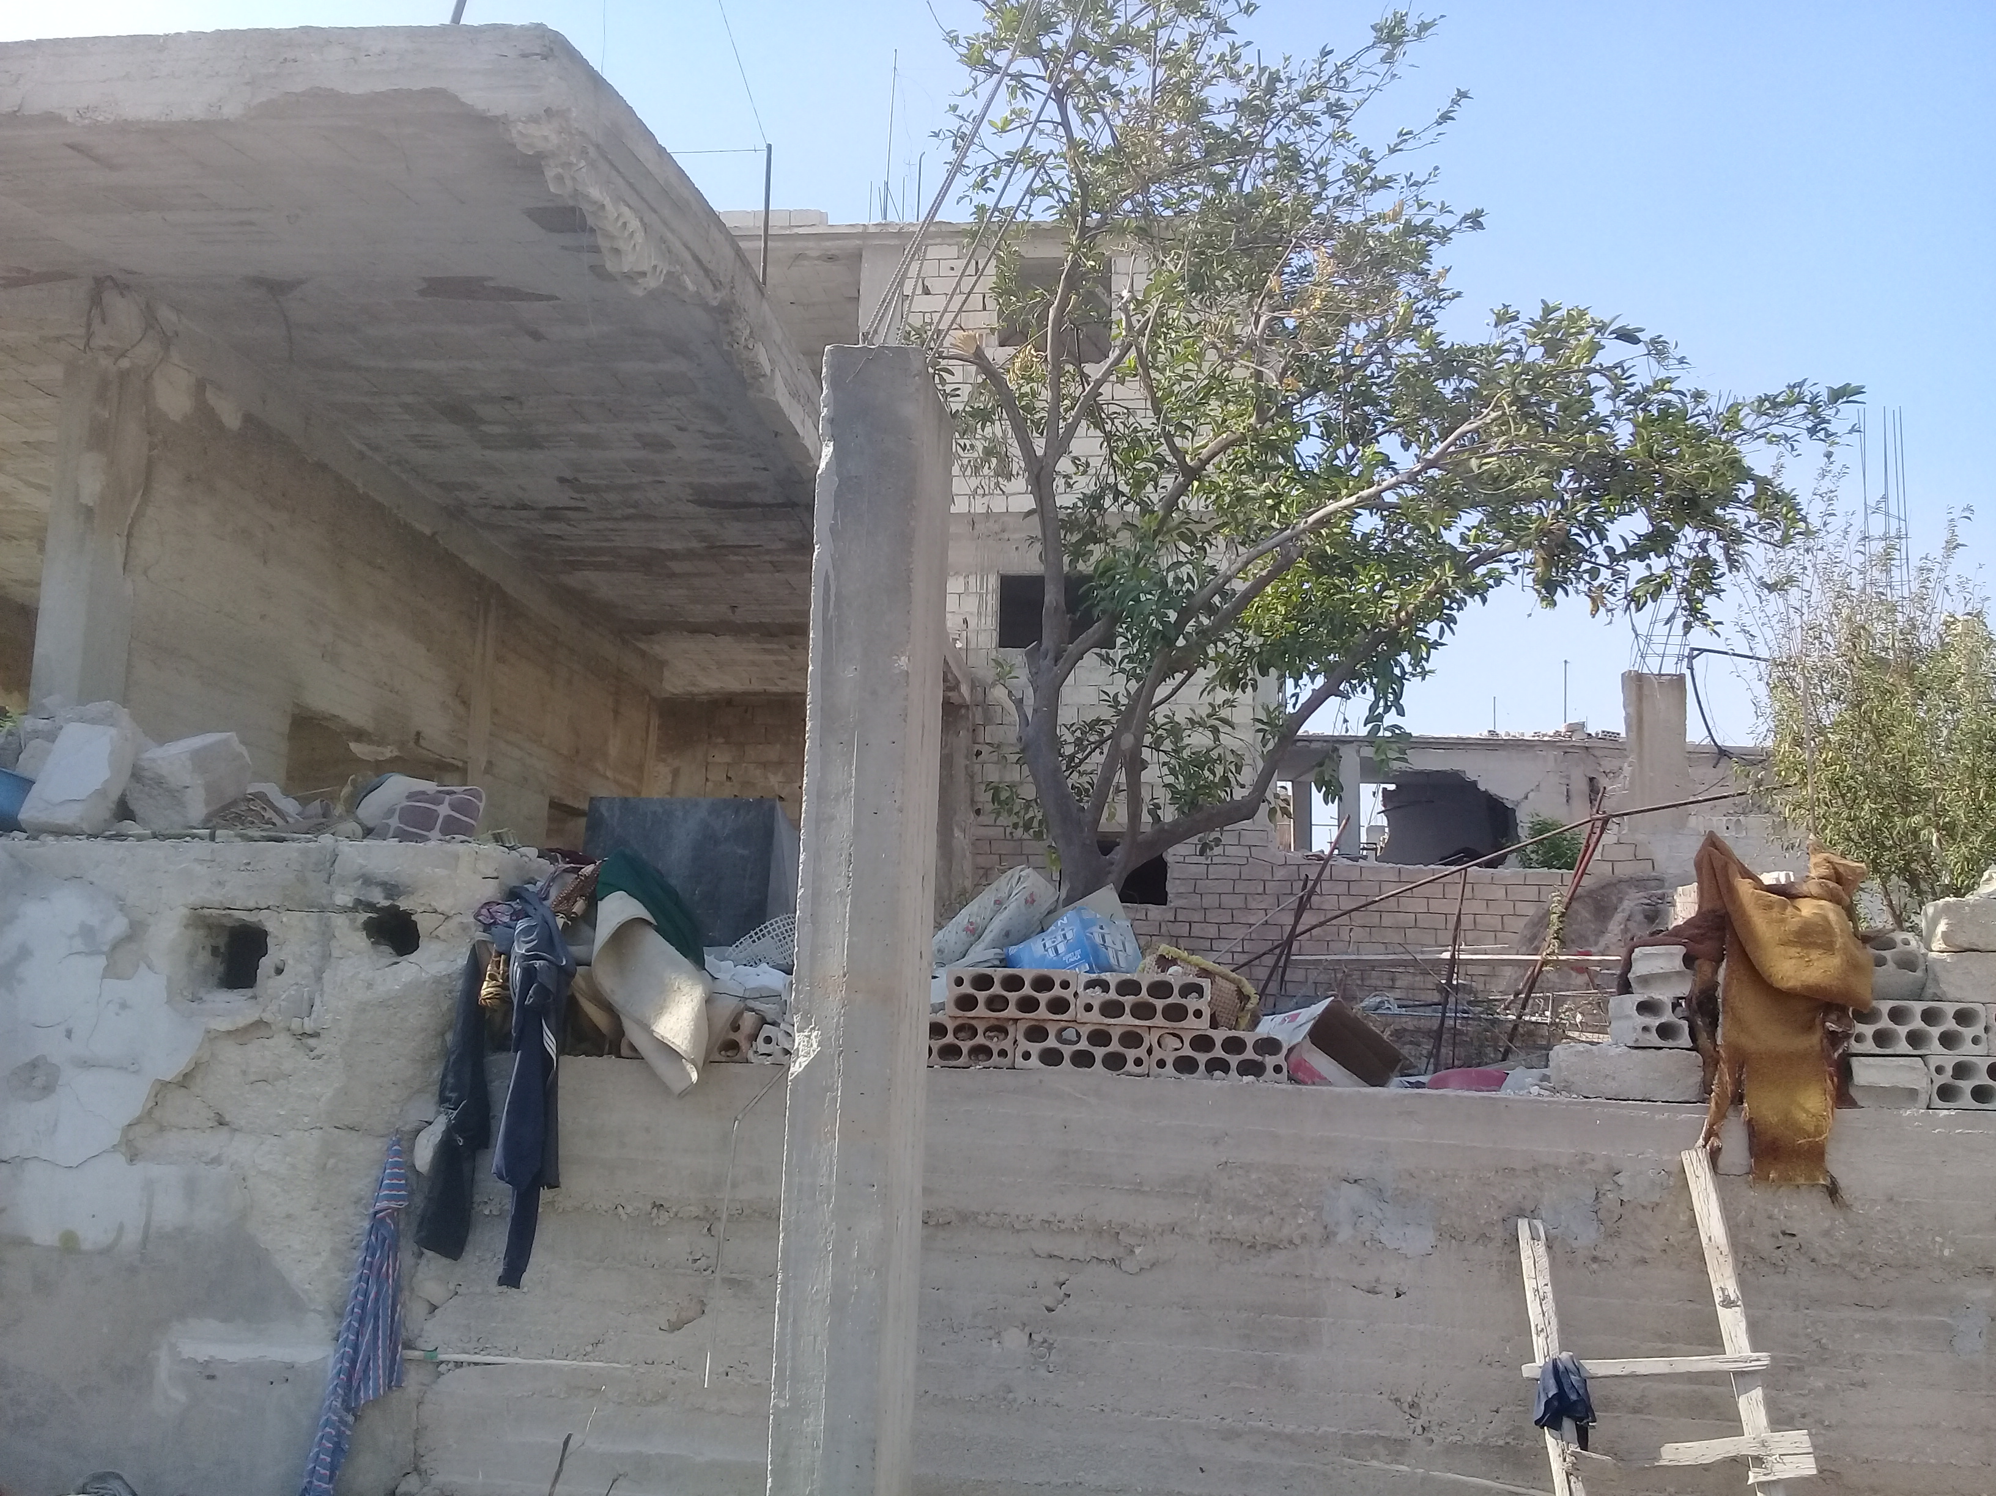
Site reported as an active medical facility

Slide 10
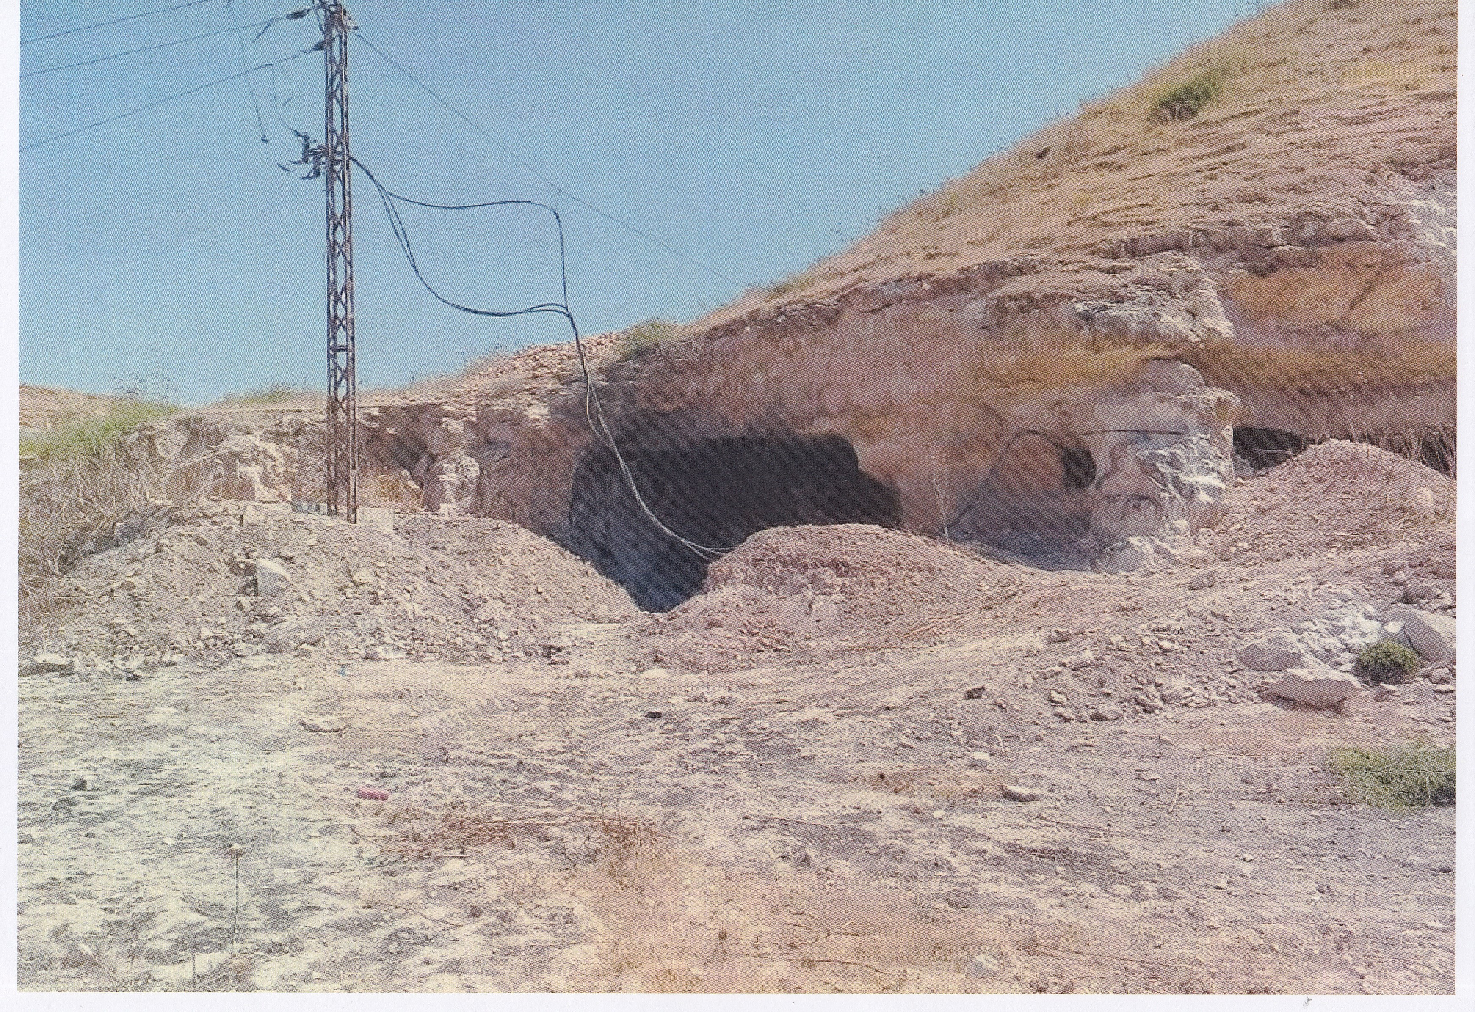
Electric conduit
with working power lines
Markings left by heavy vehicles

Slide 11
Weapon emplacement camouflaged as ambulance

Slide 12
HOBAIT, IDLIB

Slide 13
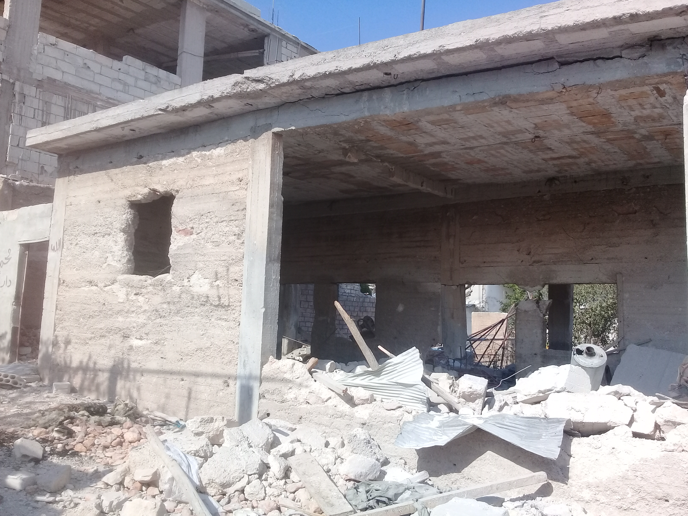
One-storeyed building,
located at the frontline
NO TRACES OF MEDICAL USAGE FOUND
Was listed as ‘Al-Hobeit medical facility’
Reported as ‘hit’ in June 2019

Slide 14
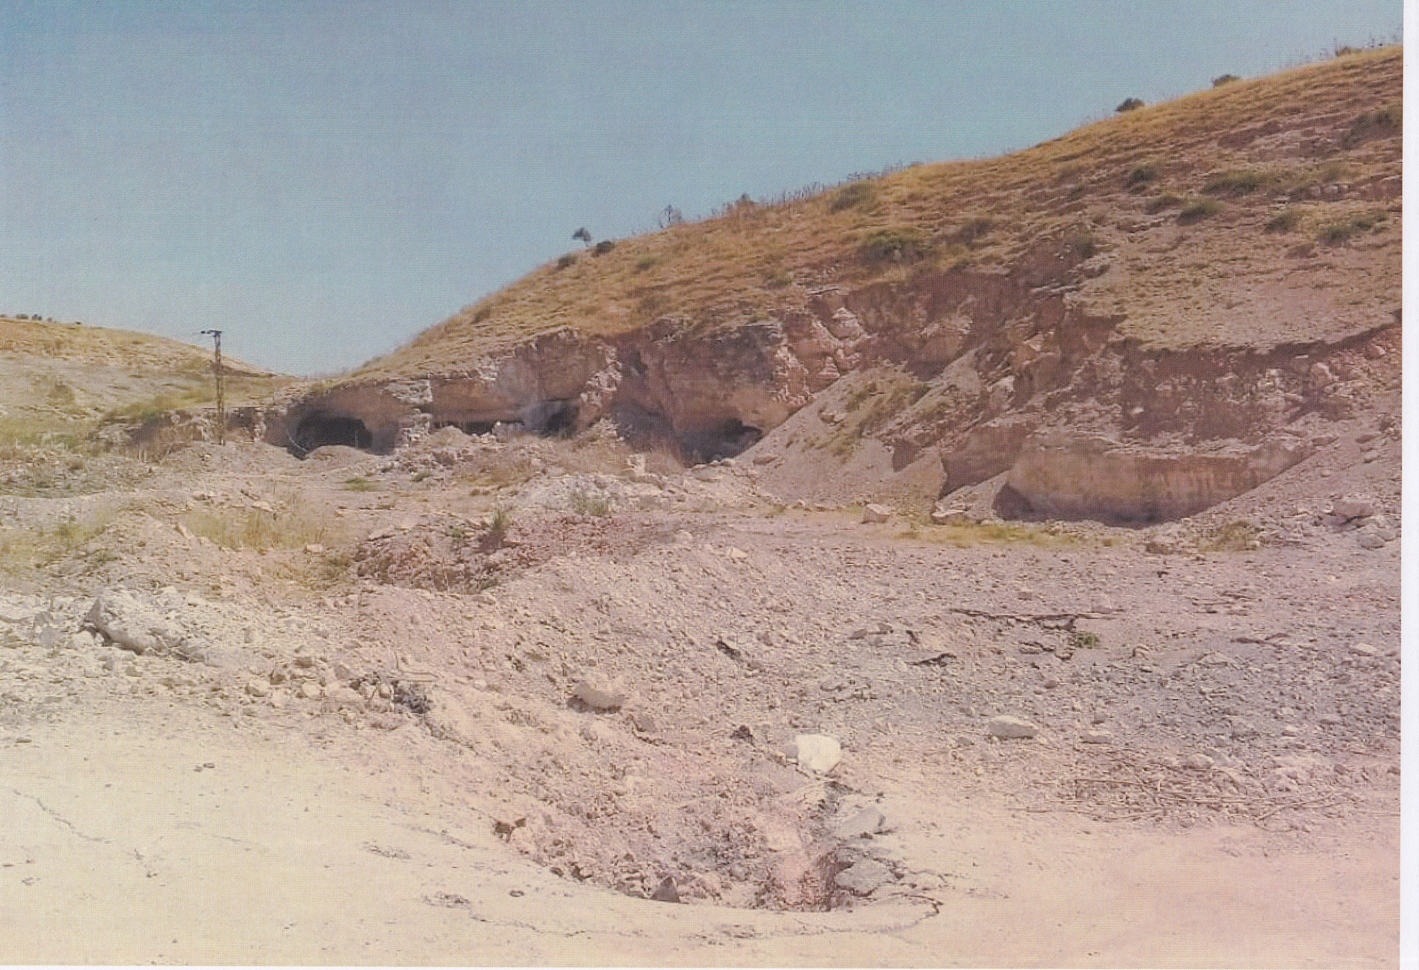
Underground facility listed as
‘Kafer Zaita Public Health Facility’
Reported as ‘hit’ in June 2019

Slide 15
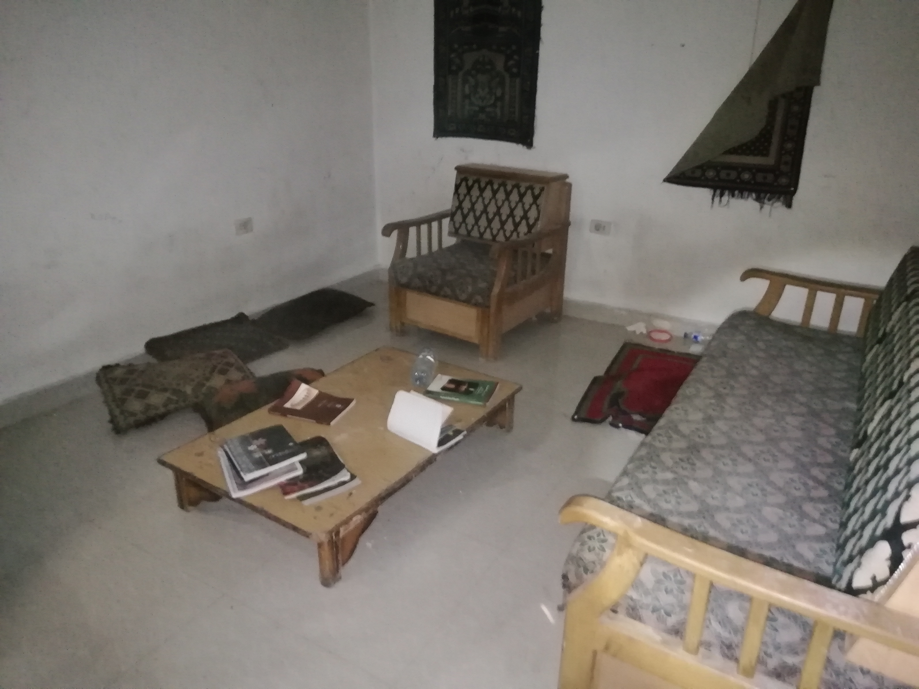
Condition of interior chambers shows no damage

Slide 16
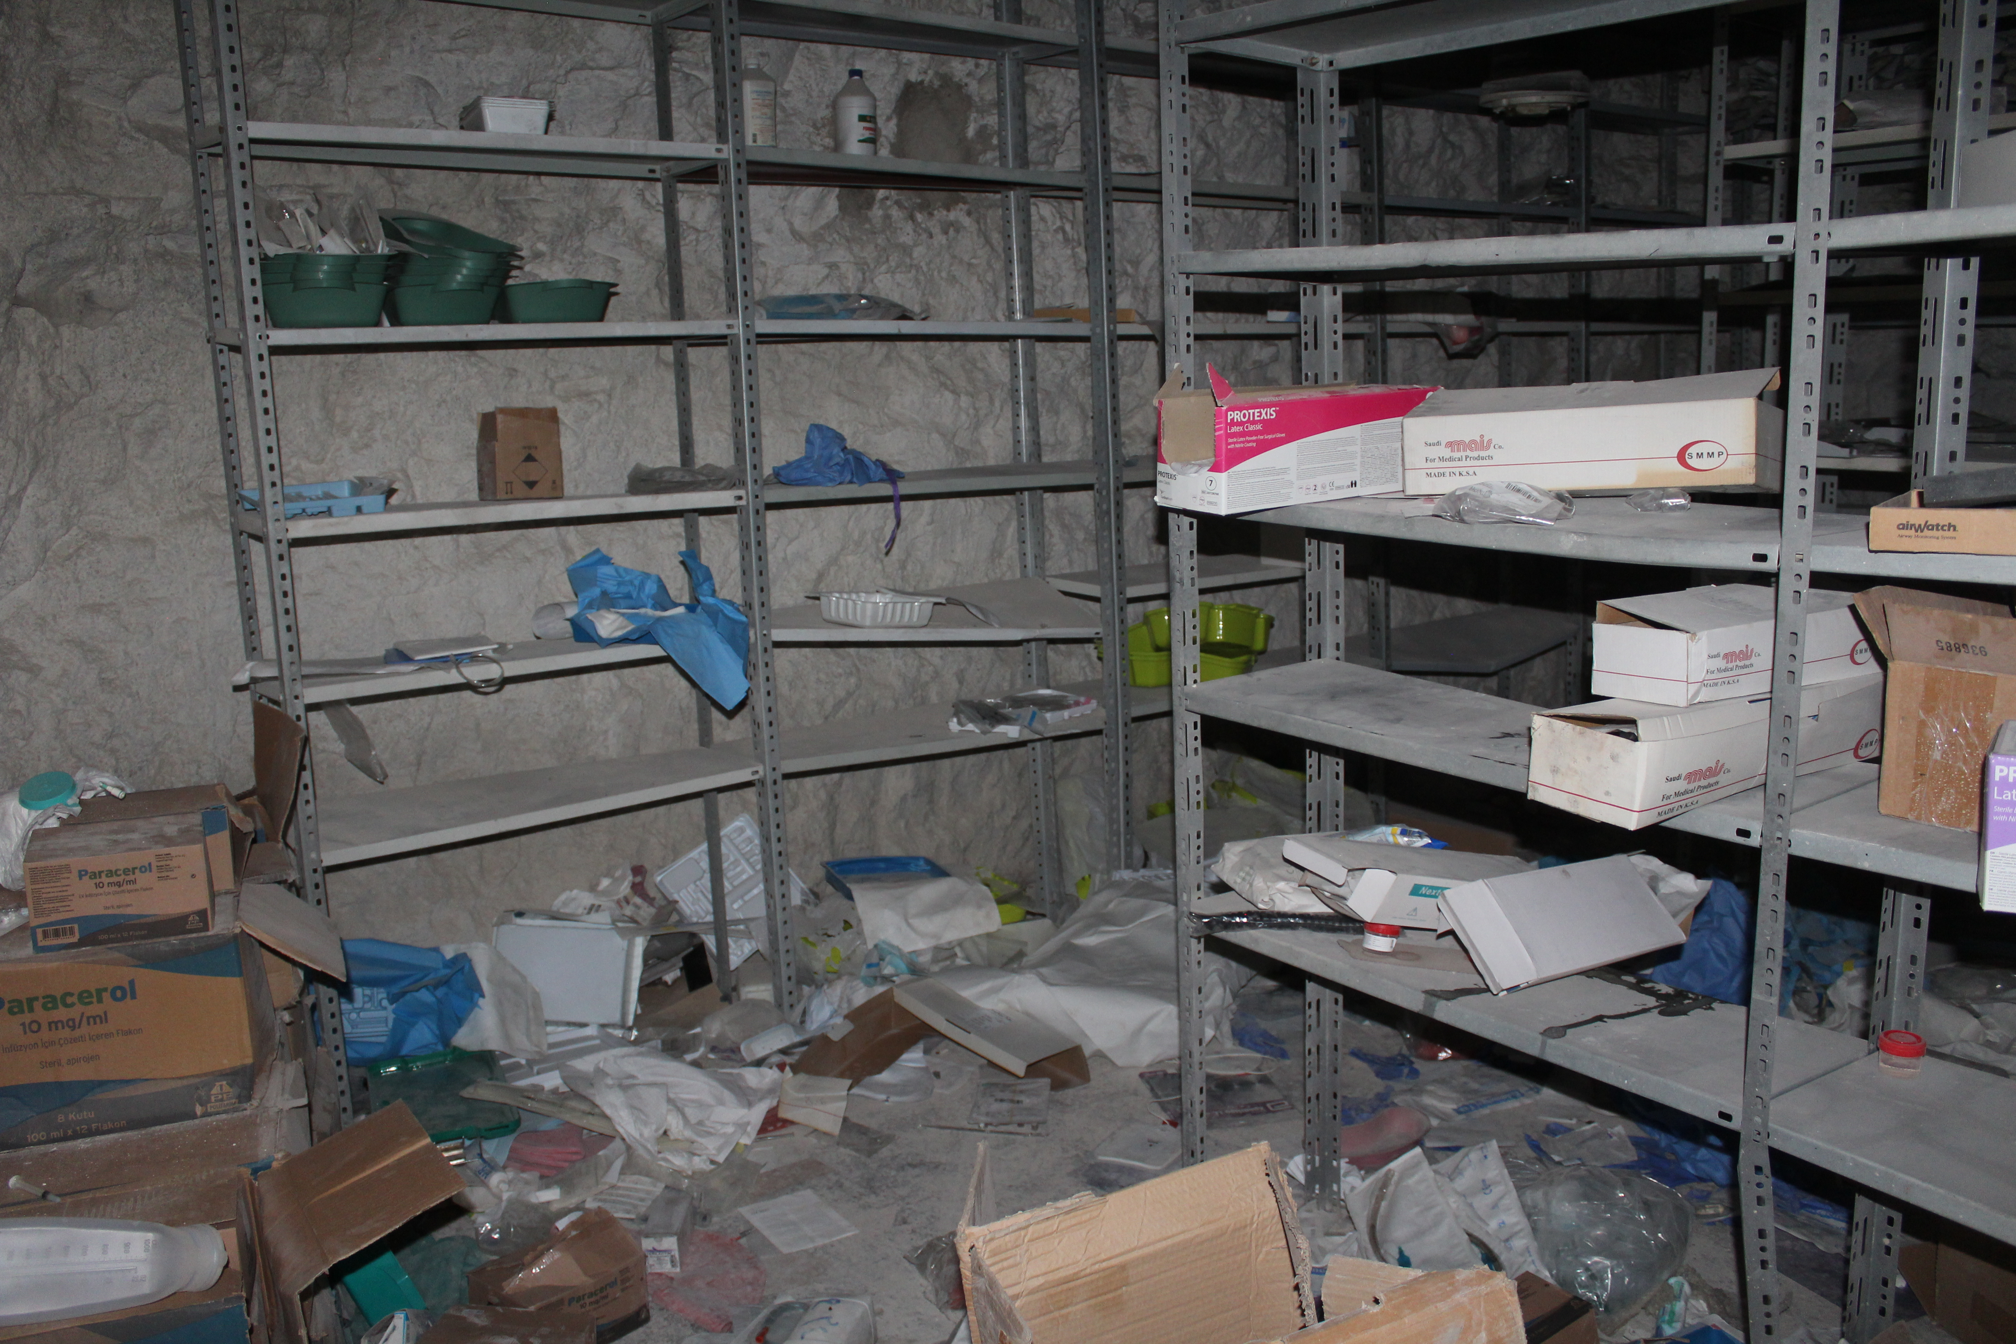
Storage room also intact
Facility was well supplied, some items were even left behind

Slide 17
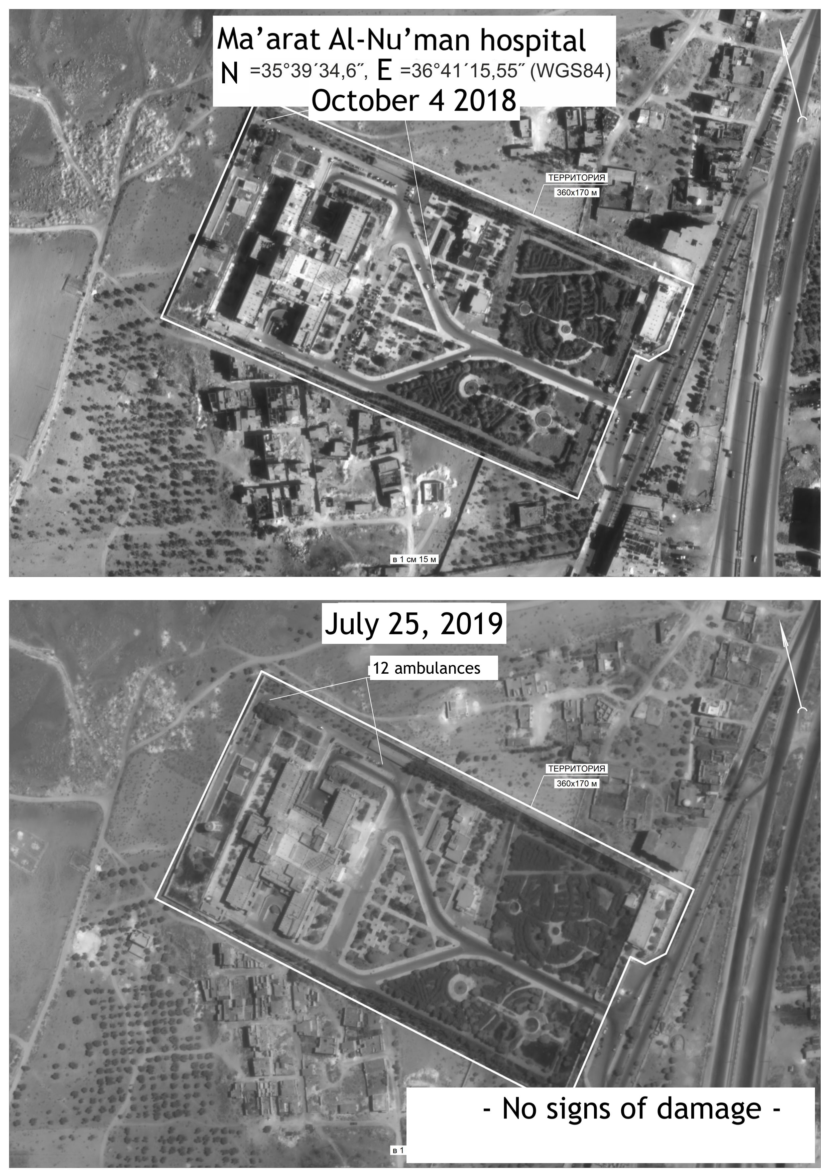
Reported as ‘hit’ in June 2019

Slide 18
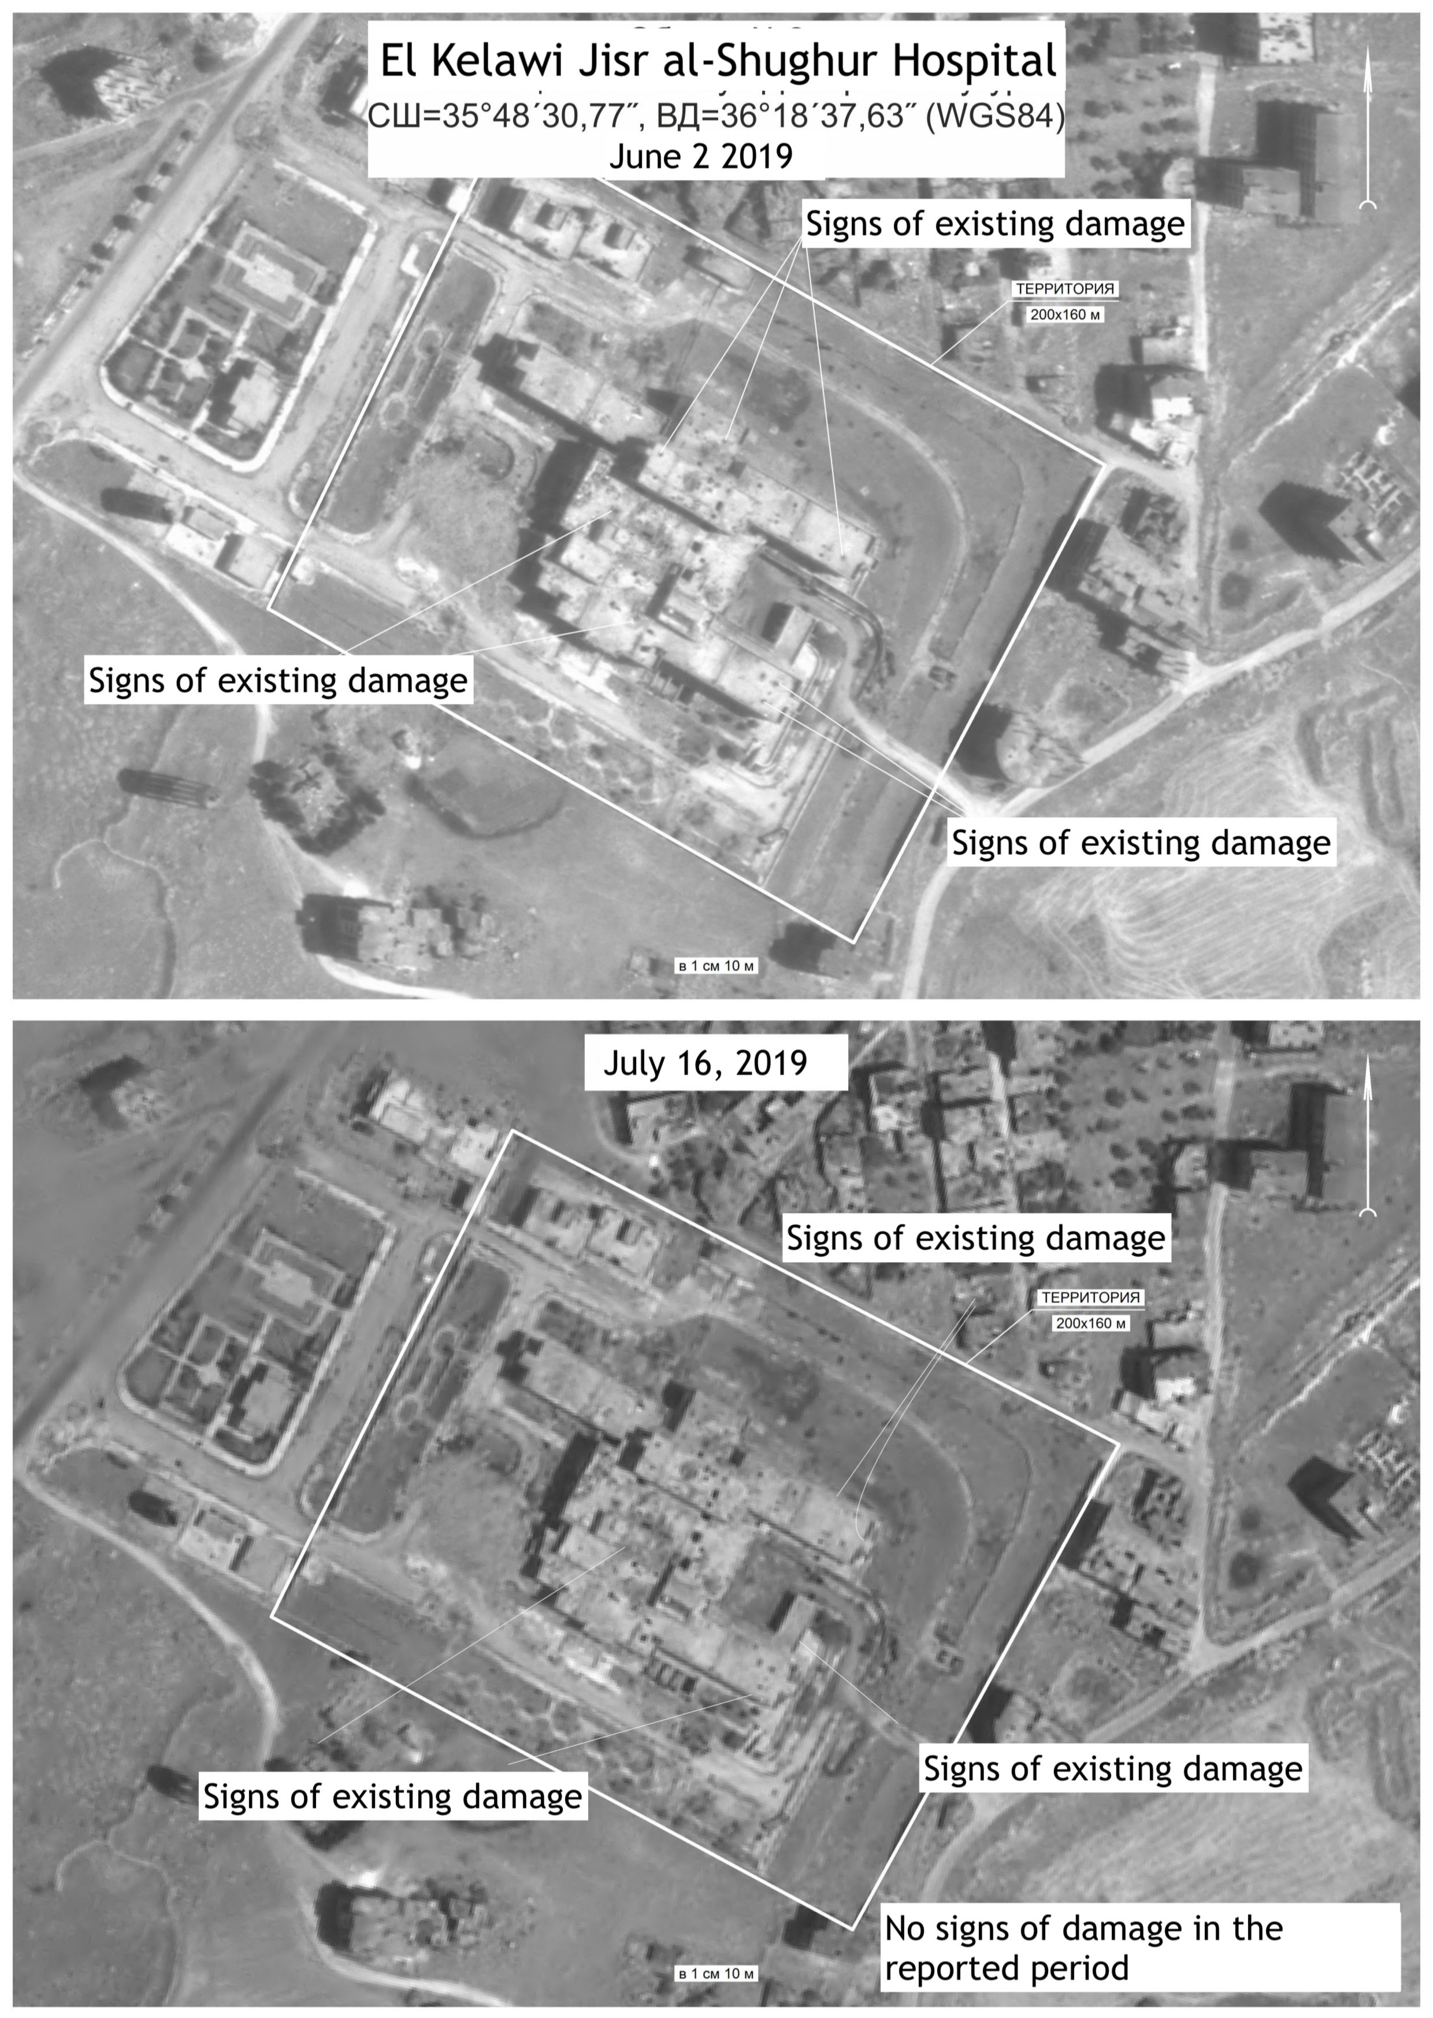

Slide 19
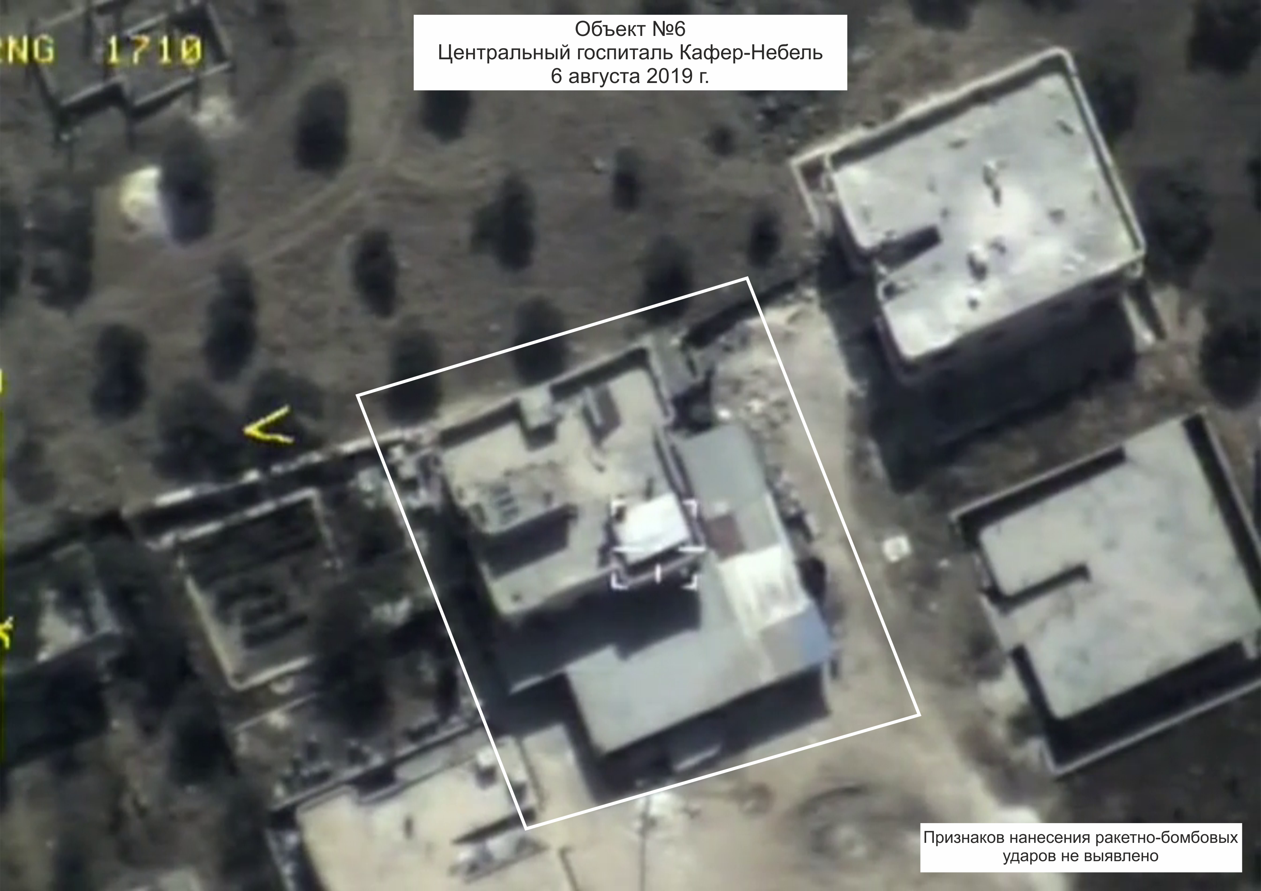
Kafr Nebel Central Hospital
August 6, 2019
No signs of damage on the building and surroundings

Slide 20
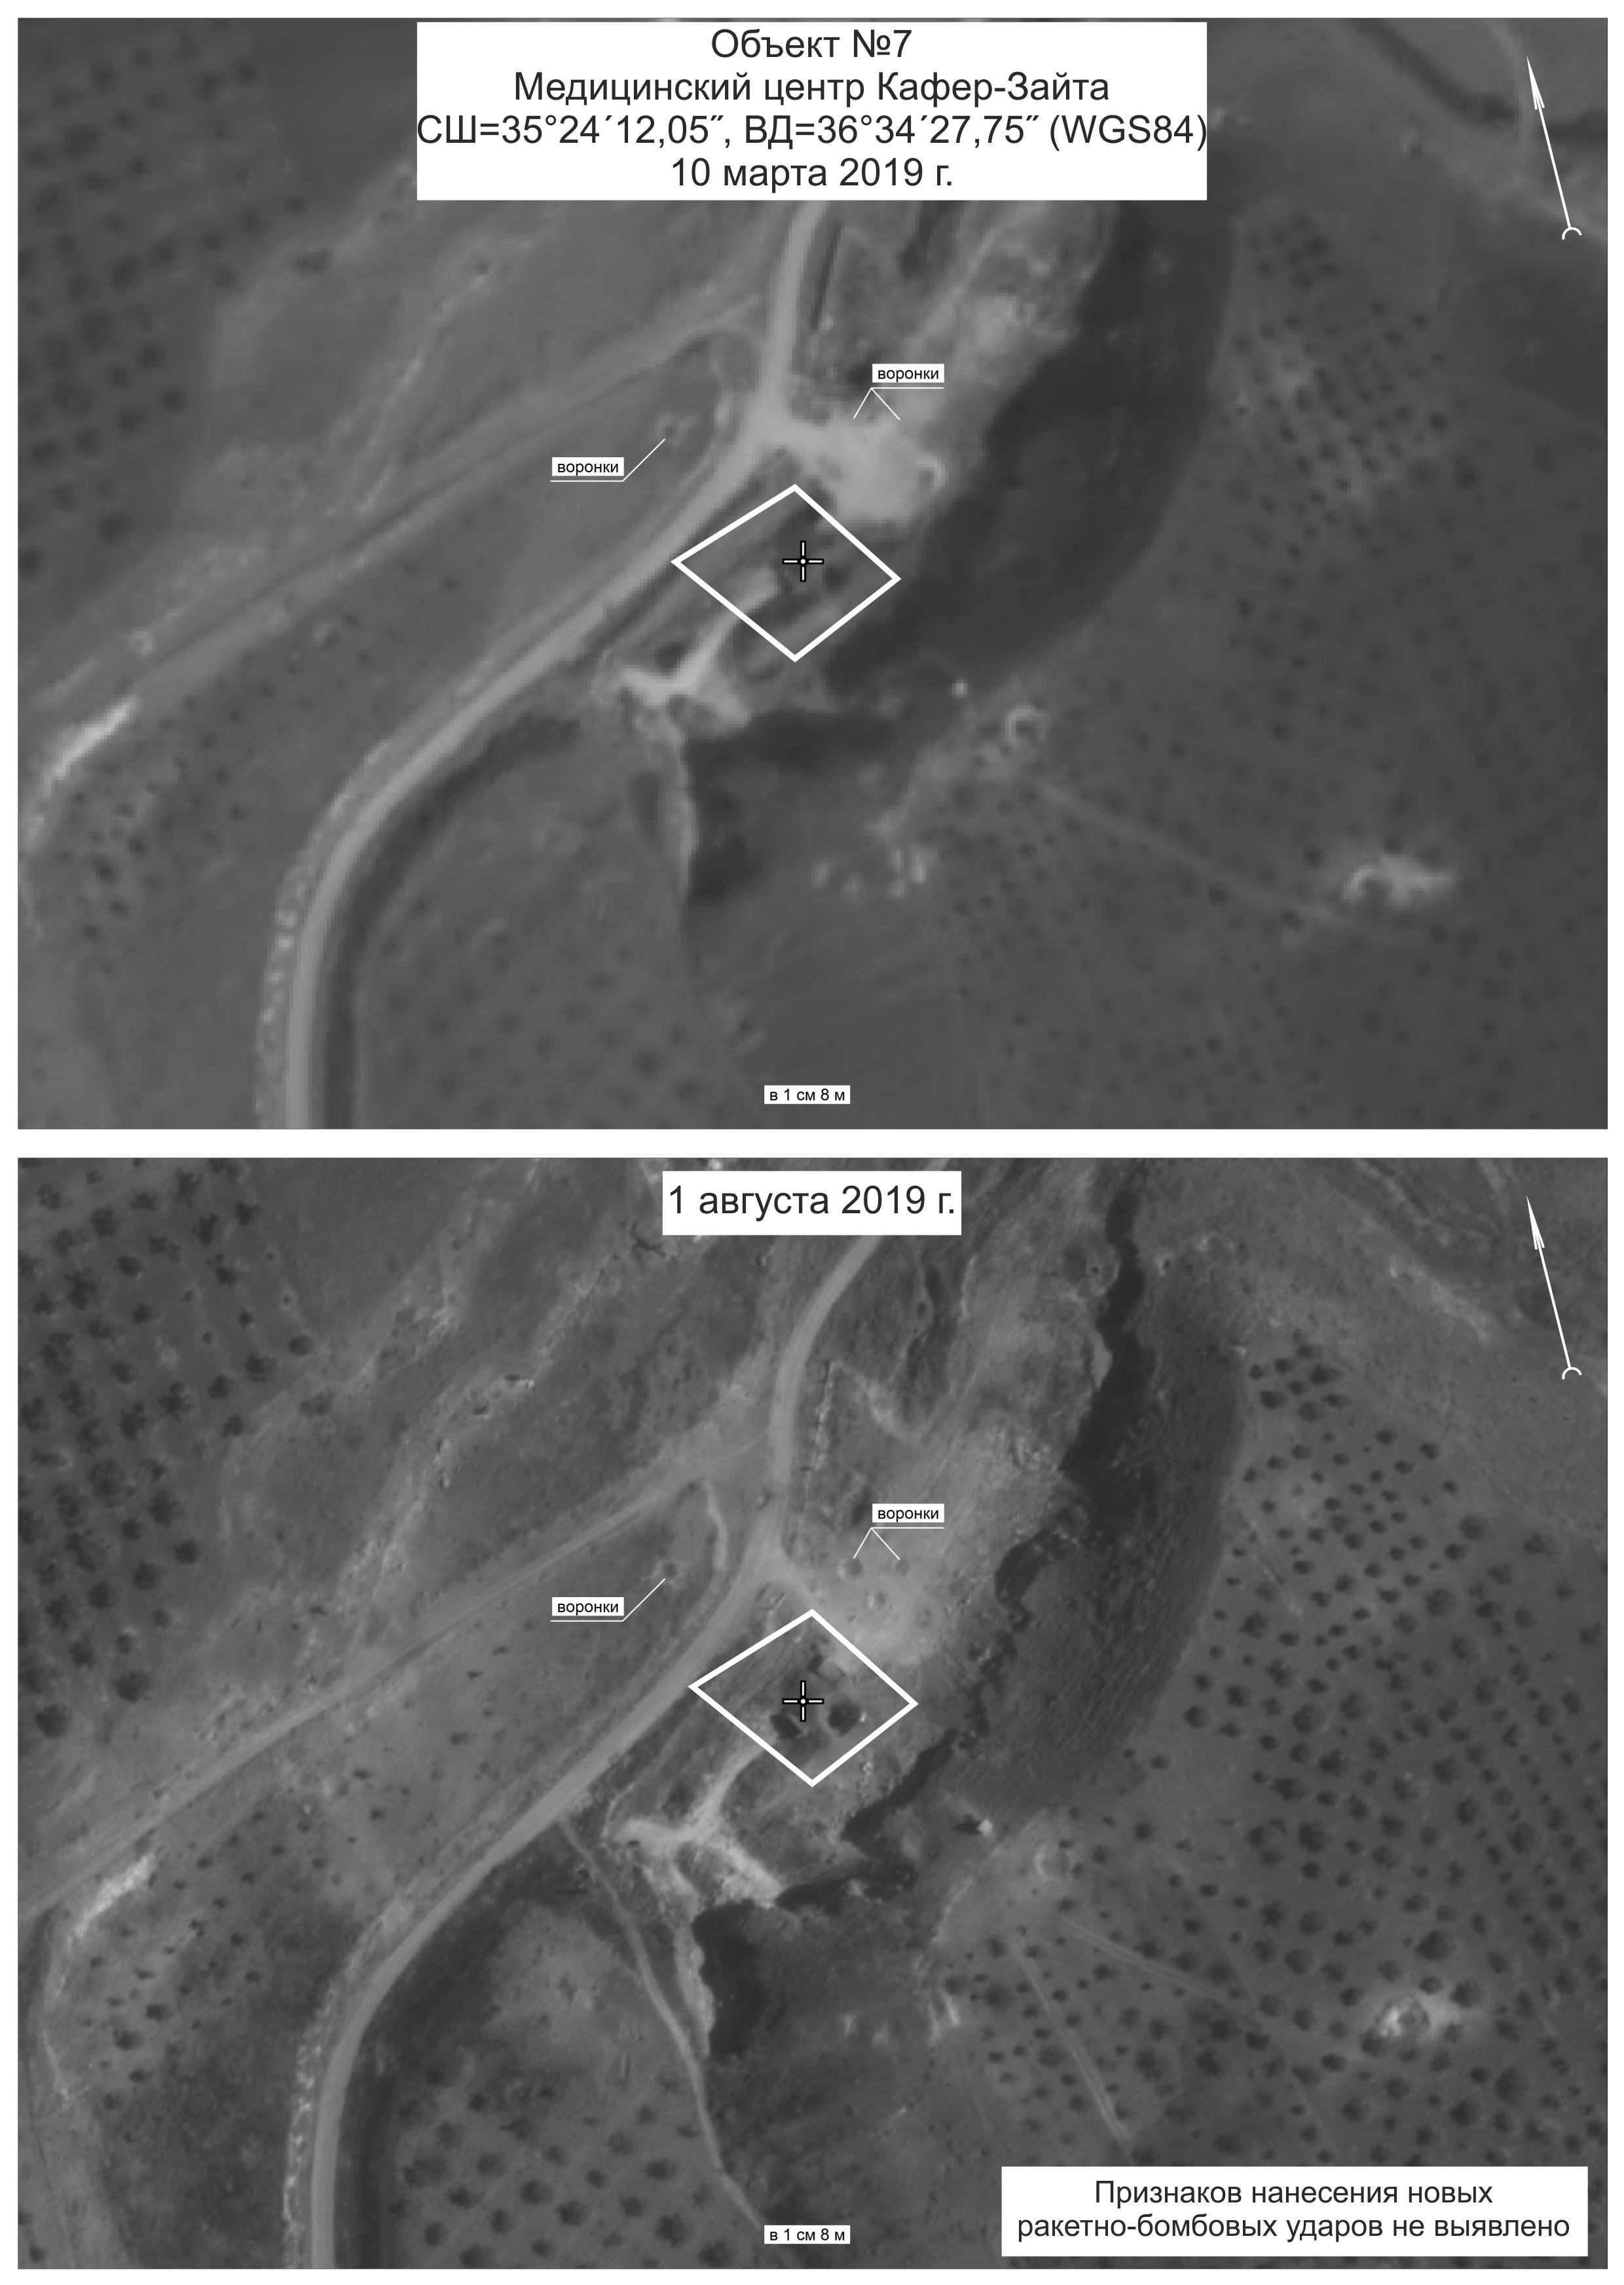
Kafer Zaita underground facility
(35°24'12.1"N 36°34'27.8"E)
March 10, 2019
Reported as ‘hit’ in June 2019
August 1, 2019
No signs of hits in the reported period

Slide 21
Reports on alleged attacks on healthcare in Idlib, Syria Press conference of the Permanent Representative of the Russian Federation to the United Nations MR.VASSILY NEBENZIA
Permanent Mission
of the Russian Federation
to the UN
Notes:
Work started in Syria

